Slide 1
Trees & Binary Trees

Slide 2
Overview
Trees Ch 10.4, 12.1
Representing rooted trees
Binary trees Ch 12.2–3

Slide 3
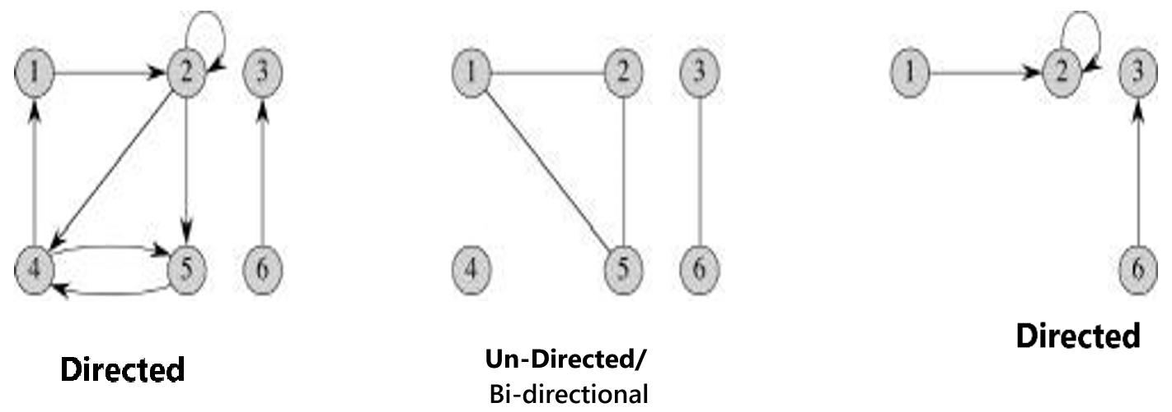
Graphs
Graphs have vertices (nodes) connected by edges . Graph, G = (V , E) ^{In graph,}
^{node = Vertex,}
^{nodes = vertices}
connection between 2 nodes = edge
Image:¹
¹Cormen, Leiserson, Rivest, Stein. Introduction to Algorithms, 3rd edition, MIT Press, 2009
Trees Ch B.5, 10.4, 12.1

Slide 4
Graphs
Directed graphs: edges have direction (one-way streets)
Undirected/Bi-directional graphs: edges have no direction (two-way streets)
Image:¹
^{In graph,} ^{node = Vertex,} ^{nodes = vertices} connection between 2 nodes = edge
¹Cormen, Leiserson, Rivest, Stein. Introduction to Algorithms, 3rd edition, MIT Press, 2009
Trees Ch B.5, 10.4, 12.1

Slide 5
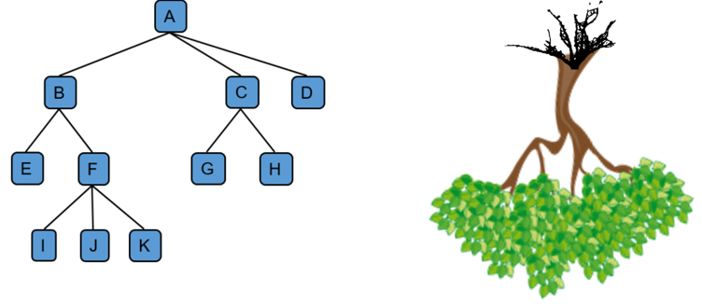
Trees and forests
Trees are graphs with special properties
Tree is a non-linear data structure that allows us to organize, access and update data efficiently by representing non-linear data in a form of hierarchy.
A graph that contains a cycle is never a tree
Image: https://sites.ualberta.ca/~rosanna/books/PDSA/chapter8/tree.html
Trees Ch B.5, 10.4, 12.1

Slide 6
Trees and forests
Applications of tree
Continuous Sorting with Trees: Using a Binary Search Tree (BST), new data can be inserted in a sorted manner without re-sorting the entire array.
Folder/File System: A tree structure represents folders (branches) and files (leaf nodes) in a system, with the desktop as the root.
Electrical Circuit Design: Trees model electricity distribution from a central point to homes and industries.
Network Routing: Trees are used to determine efficient routes for data packets in computer networks.
Trees Ch B.5, 10.4, 12.1

Slide 7
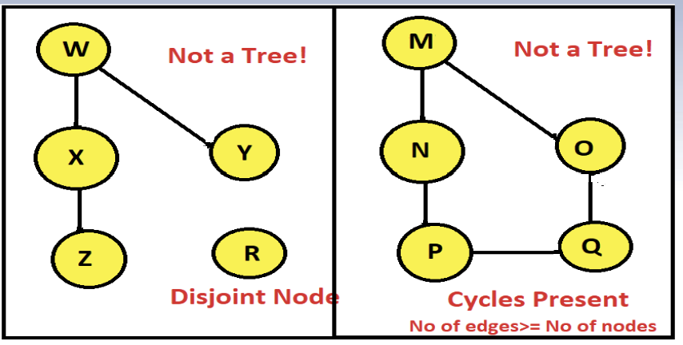
Trees
The most general type of tree is a free tree (or tree)
Properties of free trees/tree:
undirected: Any two vertices in a free tree are connected by a unique path
connected (continuous and not disjoint): If a single edge is removed from a free tree, it becomes disconnected.
Every single node must be traversable starting from the root node.
acyclic: If any edge is added to a free tree, it becomes a graph with a cycle (no longer a tree)
A tree with n nodes will have n or more edges if it has cycles.
For a tree, no of edges == no of nodes - 1.
Trees Ch B.5, 10.4, 12.1

Slide 8
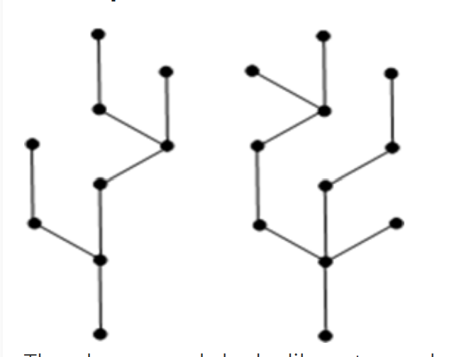
Forests
Forest: Forest is a disjoint collection of trees
Each component of a forest is tree.
An 1) undirected, 2) acyclic graph that is 3) not connected (disconnected) is a forest
The graph on left looks like a two sub-graphs but it is a single disconnected graph. There are no cycles in the above graph. Therefore it is a forest.
Trees Ch B.5, 10.4, 12.1

Slide 9
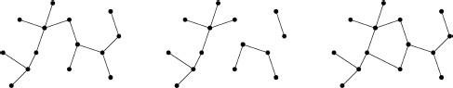
Trees and forests
Image:²
²Cormen, Leiserson, Rivest, Stein. Introduction to Algorithms, 3rd edition, MIT Press, 2009
Trees Ch B.5, 10.4, 12.1

Slide 10
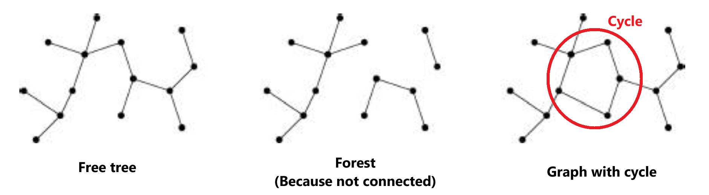
Trees and forests
Image:²
²Cormen, Leiserson, Rivest, Stein. Introduction to Algorithms, 3rd edition, MIT Press, 2009
Trees Ch B.5, 10.4, 12.1

Slide 11
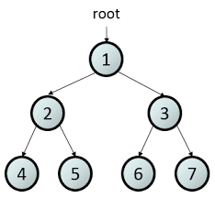
Rooted tree
A free tree in which one node is specially marked as root
In rooted trees, we can talk about parent, child, sibling, subtrees, leaves, internal nodes
Depth and height are defined for rooted trees
Image: https://sites.ualberta.ca/~rosanna/books/PDSA/chapter8/tree.html
Trees Ch B.5, 10.4, 12.1

Slide 12
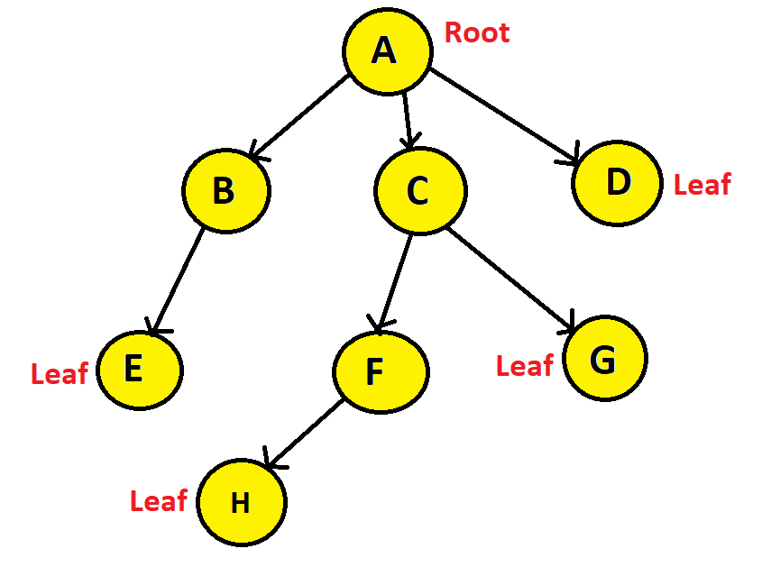
Terminology
Root node : Node without any parent, the topmost node.
If we have access to the root node, we have access to the entire tree. (similar to head of linked list)
Leaf: A node without child / children
Trees Ch B.5, 10.4, 12.1
6/21

Slide 13
Terminology
Internal nodes: The root node and the non-leaf nodes Nodes A is root, and B, C, and F are non-leaf nodes.
Thus, A, B, C, F are internal nodes.
Trees Ch B.5, 10.4, 12.1
7/21

Slide 14
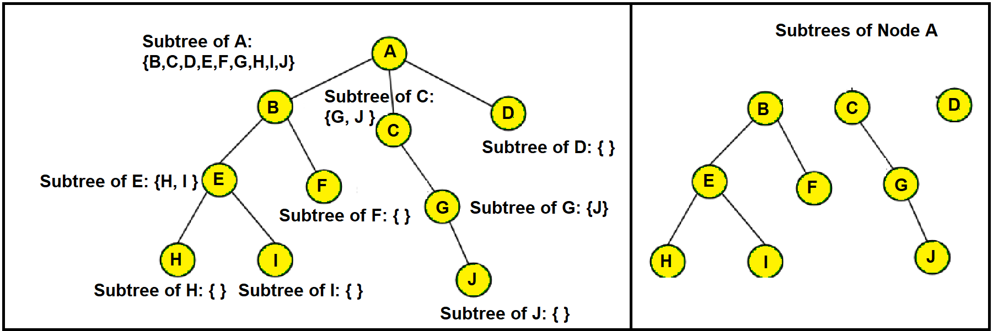
Terminology
Subtree: A tree that is the child of a Node.
Any tree can be further divided into subtrees with respect to a particular node.
Here, node A has three subtrees that are shown on the right side.
Trees Ch B.5, 10.4, 12.1
7/21

Slide 15
Terminology
Parent-Child node:
A is a parent of B and B is a child of A, if an edge points from A to B.
A node can have only one parent
A parent, children: B, C, D B parent, child: E C parent, children: F, G F parent, child: H
Trees Ch B.5, 10.4, 12.1
6/21

Slide 16
Terminology
Siblings: Two nodes having the same parent
A parent, Siblings: B, C, D C parent, Siblings: F, G
Trees Ch B.5, 10.4, 12.1
6/21

Slide 17
Terminology
Edge: The link between two nodes. If a tree has n number of nodes, it will have (n-1) number of edges. Here, we have 8 nodes and 7 edges in total.
Path: Consecutive edges from the source node to the destination node. Question: Path from node A to E?
Trees Ch B.5, 10.4, 12.1
6/21

Slide 18
Terminology
Edge: The link between two nodes. If a tree has n number of nodes, it will have (n-1) number of edges. Here, we have 8 nodes and 7 edges in total.
Path: Consecutive edges from the source node to the destination node. Question: Path from node A to E? A→B→E.
Trees Ch B.5, 10.4, 12.1
6/21

Slide 19
Terminology
Degree: The total number of children of a node
The degree of node A is 3
The degree of node B is 1
The degree of node E is 0
The degree of node C is 2
The degree of node F is 1
The degree of node H is 0
The degree of node G is 0
The degree of node D is 0
Trees Ch B.5, 10.4, 12.1
6/21

Slide 20
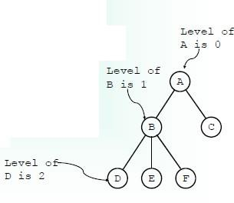
Depth/Level of a tree
The level (or depth) of a node n is equal to the number of edges from the root to that node
Image:⁵
⁵Brad Miller, David Ranum, Problem Solving with Algorithms and Data Structures, Release 3.0, 2013
Trees Ch B.5, 10.4, 12.1
8/21

Slide 21
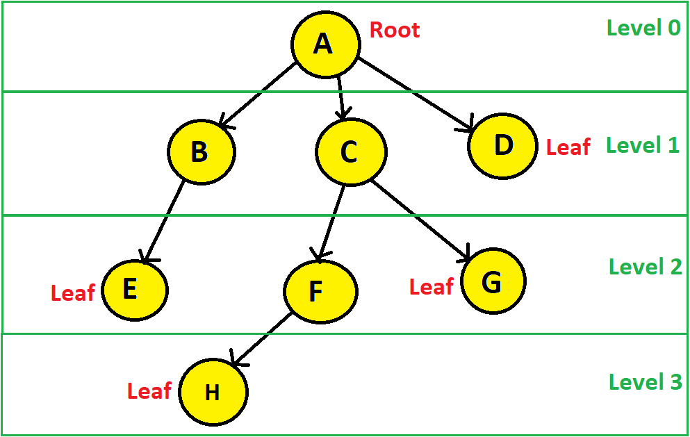
Depth/Level of a tree
The level (or depth) of a node n is equal to the number of edges from the root to that node
Trees Ch B.5, 10.4, 12.1
8/21

Slide 22
Height of a tree
Height: The length of the longest path from a node to one of its leaf nodes
The height of a Tree is equal to the maximum level of any node in tree [shortcut]
Height = max(all subtree levels) [shortcut]
From node A to the leaf nodes there are four paths:
A→B→E (edges=2)
A→C→F→H (edges=3)
A→C→G (edges=2)
A→D (edges=1)
A→C→F→H is the longest path. (edges=3) Hence, the height of Node A is 3.
Image:⁶
⁶Brad Miller, David Ranum, Problem Solving with Algorithms and Data Structures, Release 3.0, 2013
Trees Ch B.5, 10.4, 12.1

Slide 23
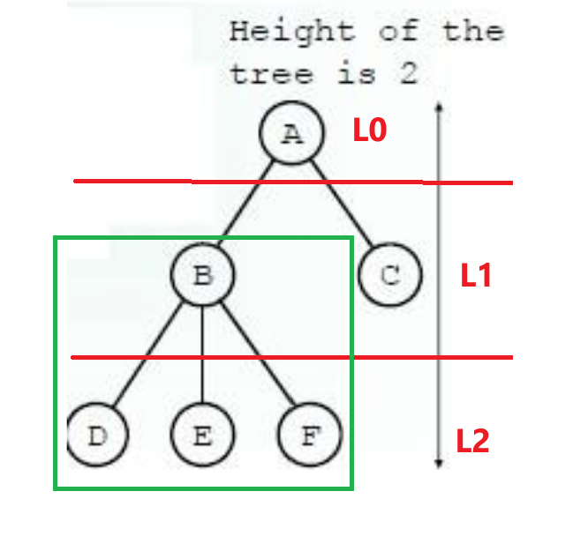
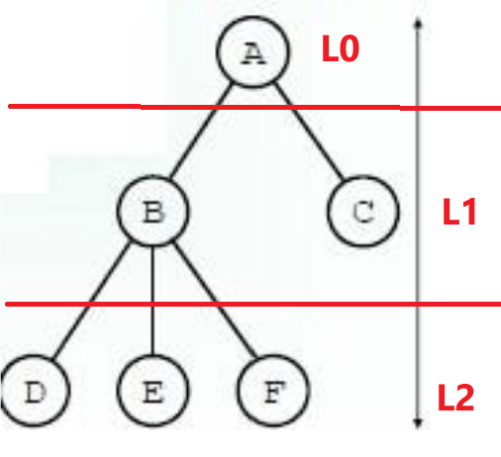
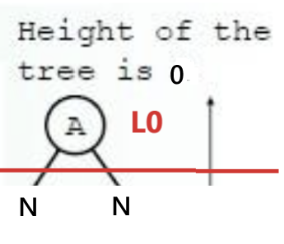
Height of a tree
Height: The length of the longest path from a node to one of its leaf nodes
If a tree consist of only the root its height is 0
Otherwise the height is 1 greater than the height of its tallest subtrees
Only 1 node, root=leaf So, height = 0
height = 1+ height of tallest subtree = 1+ (Height of B to E) = 1 + (1 + Height of D (single leaf node)) = 1 + (1 + 0) = 1 + 1 = 2
Image:⁶
⁶Brad Miller, David Ranum, Problem Solving with Algorithms and Data Structures, Release 3.0, 2013
Trees Ch B.5, 10.4, 12.1

Slide 24
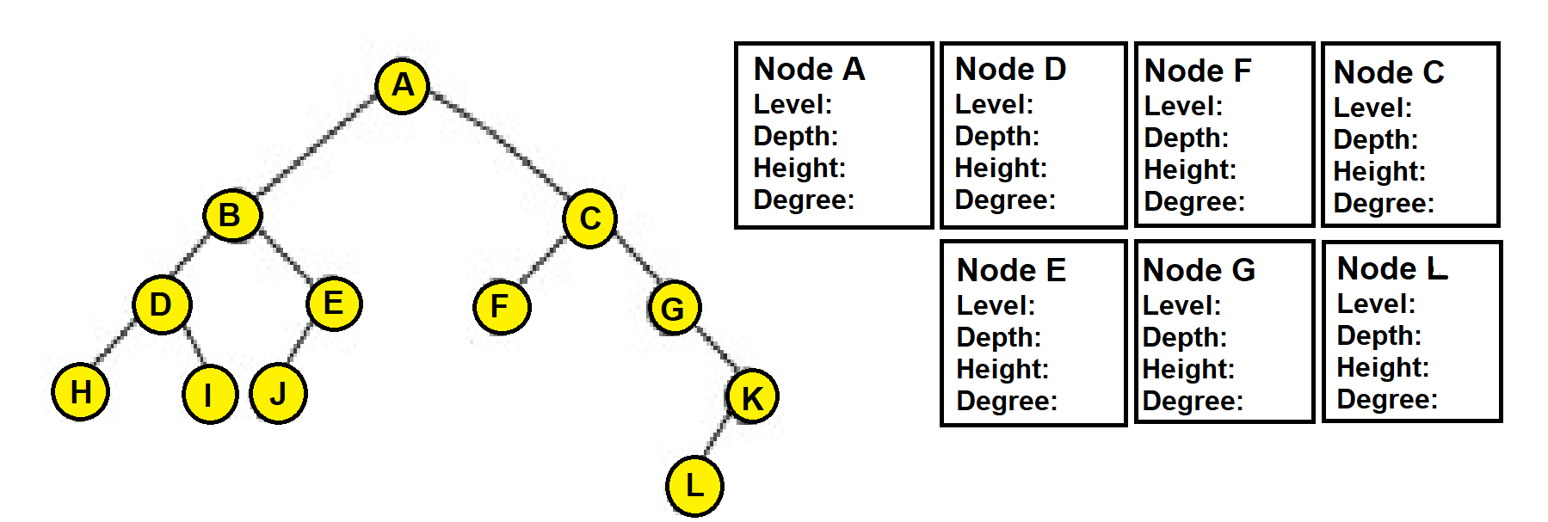
Home work
Find the level, depth, height and degree of the specified nodes of the following tree.
Trees Ch B.5, 10.4, 12.1

Slide 25
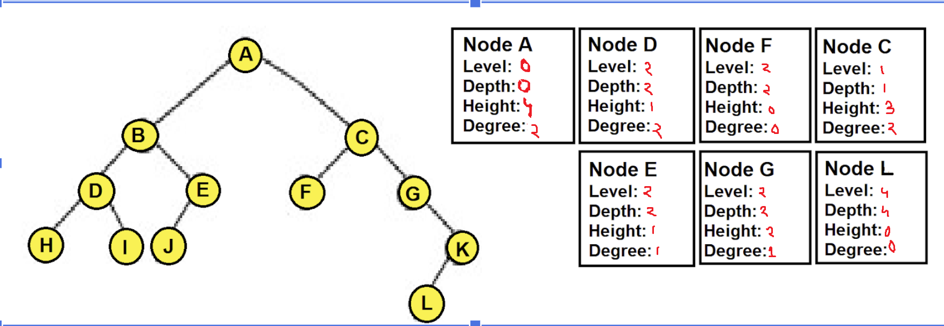
Home work
Depth/Level: root to node (no of edges in between)
Degree: no of children
Height: node to leaf node (max(no of edges))
Trees Ch B.5, 10.4, 12.1

Slide 26
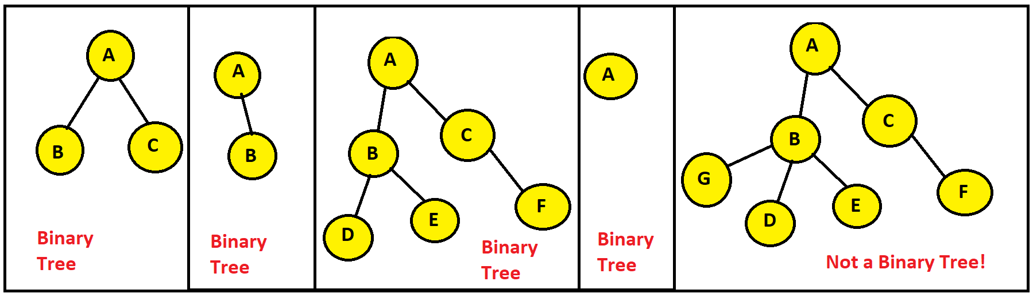
A binary tree
A tree is a binary tree if each node has at most 2 children. (0 child, 1 child or 2 children) A binary tree is a rooted tree in which every node has at most two children.
A binary tree (BT) is a structure defined on a finite set of nodes that either
contains no nodes, or
is composed of three disjoint sets of nodes:
a root node
a binary tree called left subtree
a binary tree called right subtree
Trees Ch B.5, 10.4, 12.1

Slide 27
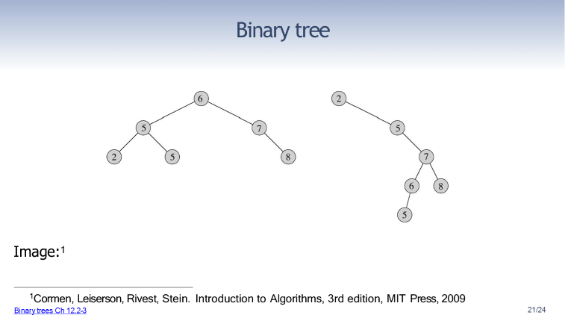
A binary tree
A tree is a binary tree if each node has at most 2 children.
A binary tree (BT) is a structure defined on a finite set of nodes that either
contains no nodes, or
is composed of three disjoint sets of nodes:
a root node
a binary tree called left subtree
a binary tree called right subtree
Trees Ch B.5, 10.4, 12.1

Slide 28
Characteristics of a Binary Tree
Each node can have at most two child nodes
Node Relationships:
Internal nodes: n
External nodes: n+1
Total edges: 2n
Internal edges: n−1
External edges: n+1
Binary Tree Properties: [memorisation not needed]
Max nodes in height h: 2^(h+1)−1
Max nodes at level i: 2^i
Trees Ch B.5, 10.4, 12.1

Slide 29
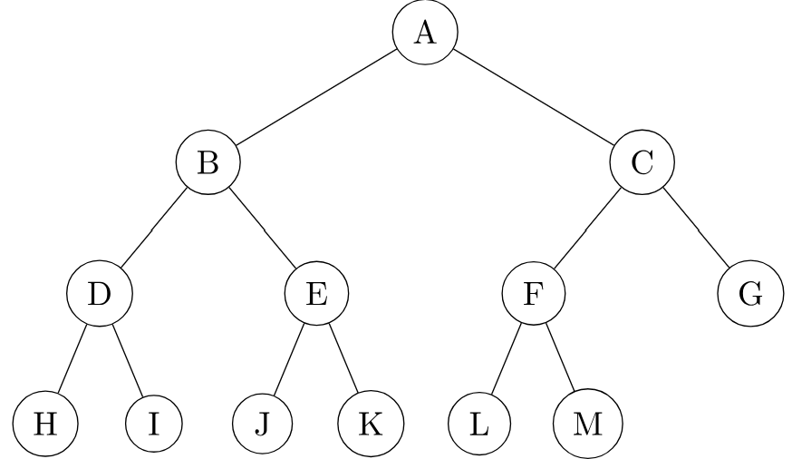
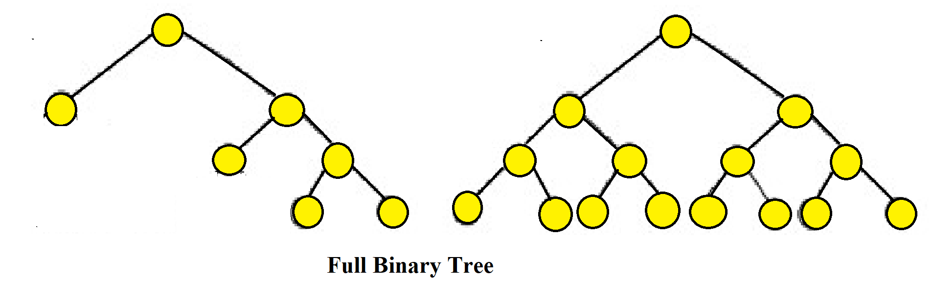
Types of Binary Tree
Full/Strict Binary Tree:
Internal nodes (every node except the leaf nodes) have two children.
every node has either 0 or 2 children
Any binary tree that maintains the following condition is a full binary tree:
No of leaf nodes = no of internal nodes + 1
In the left tree, there are 3 internal nodes and 4 leaf nodes. | In the middle tree, there are 7 internal nodes and 8 leaf nodes. | In the right tree, there are 6 internal nodes and 7 leaf nodes.
Trees Ch B.5, 10.4, 12.1

Slide 30
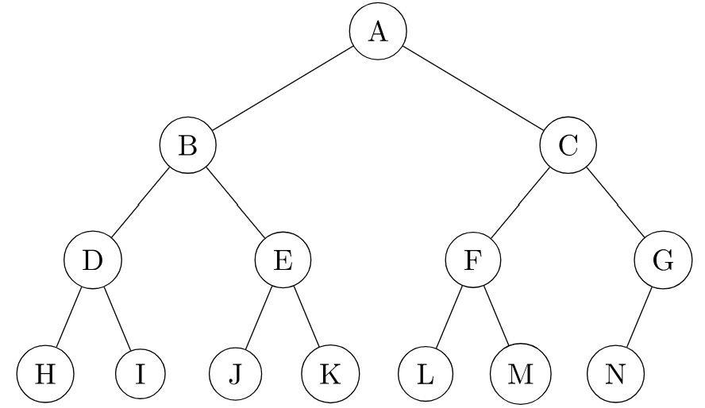
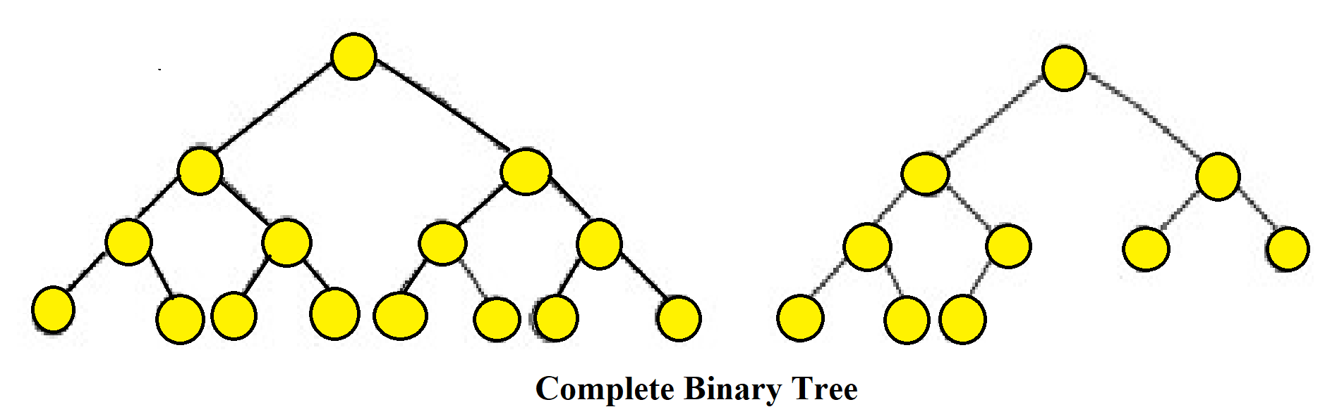
Types of Binary Tree
Complete Binary Tree:
All levels are completely filled except the lowest, every node should reside on the left side.
How can we identify a complete binary tree?
All internal nodes with two children.
If an internal node has one child, it must be on the left.
In the leftmost tree, all internal nodes have two children. | In the middle tree, all internal nodes except one have two children. The single internal node with one child has it on the left. | In the rightmost tree, all internal nodes except one have two children. The single internal node with one child has it on the left.
Trees Ch B.5, 10.4, 12.1

Slide 31
Full and complete binary tree
A complete binary tree is just like a full binary tree, but with two major differences
All the leaf elements must lean towards the left.
The last leaf element might not have a right sibling i.e. a complete binary tree doesn't have to be a full binary tree.
Trees Ch B.5, 10.4, 12.1

Slide 32
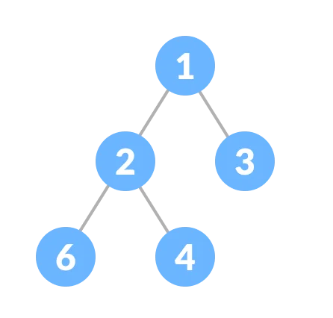
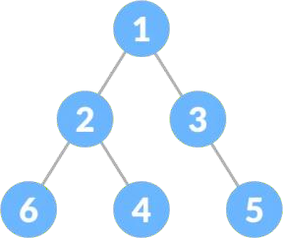
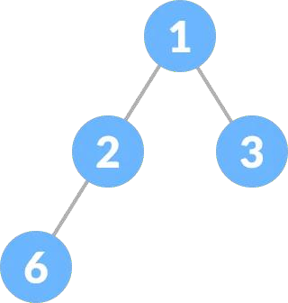
Full vs complete binary tree
Full/Strict Binary Tree:
1) Every node has either 0 or 2 children.
2) No of leaf nodes = no of internal nodes + 1
Complete Binary Tree:
1) All internal nodes with two children.
2) If an internal node has one child, it must be on the left.
Source: https://www.programiz.com/dsa/complete-binary-tree

Slide 33
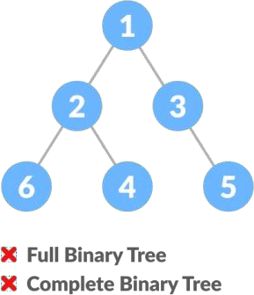
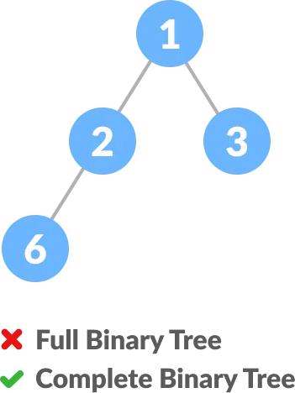
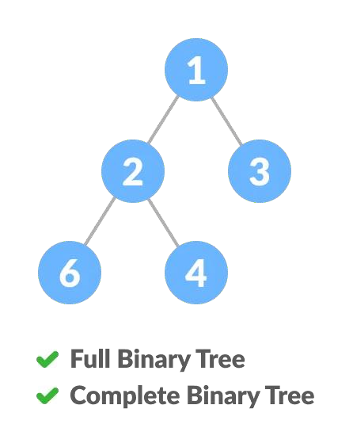
Full vs complete binary tree
Full/Strict Binary Tree:
1) Every node has either 0 or 2 children.
2) No of leaf nodes = no of internal nodes + 1
Complete Binary Tree:
1) All internal nodes with two children.
2) If an internal node has one child, it must be on the left.
Source: https://www.programiz.com/dsa/complete-binary-tree

Slide 34
Full vs complete binary tree
Full | Node 3 does not have 2 children | Node 2 does not have 2 children | Every node has either 0 or 2 children
Complete | node 3 is missing left child, and it has a right child, 5 | Node 1 has 2 child, node 3 does not have any child, node 2 has child on left side | All internal nodes (1, 2) has 2 children.
Source: https://www.programiz.com/dsa/complete-binary-tree

Slide 35
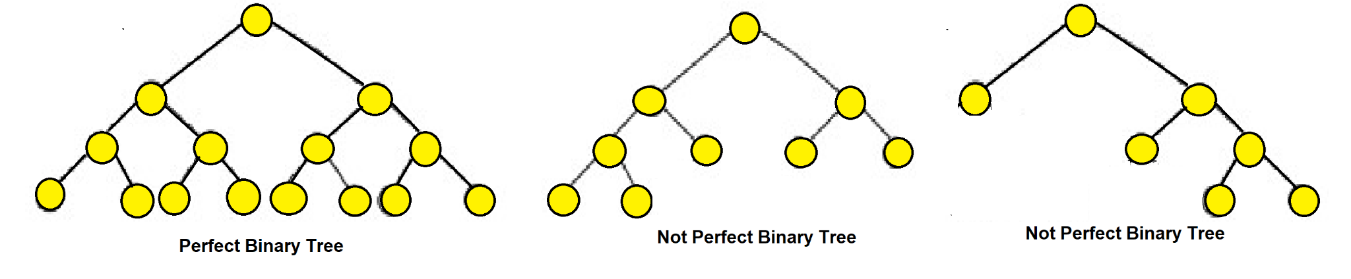
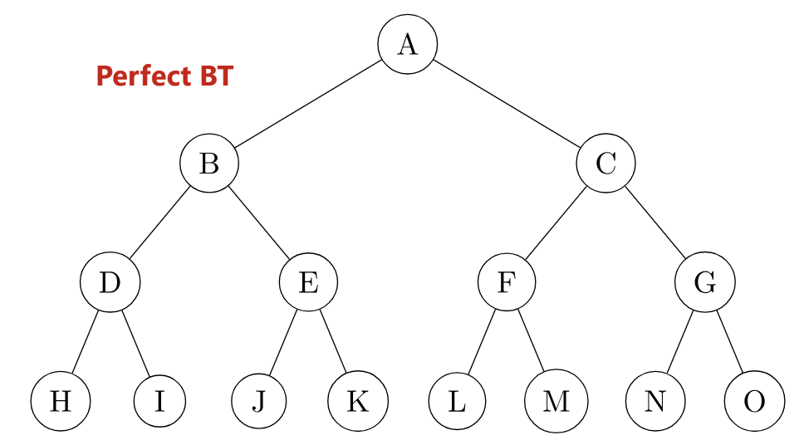
Types of Binary Tree
Perfect Binary Tree:
Every internal node has exactly two child nodes and all the leaf nodes are at the same level.
In the middle tree, all the leaf nodes are not on the same level. | In the rightmost tree, all the leaf nodes are not on the same level.
Trees Ch B.5, 10.4, 12.1

Slide 36
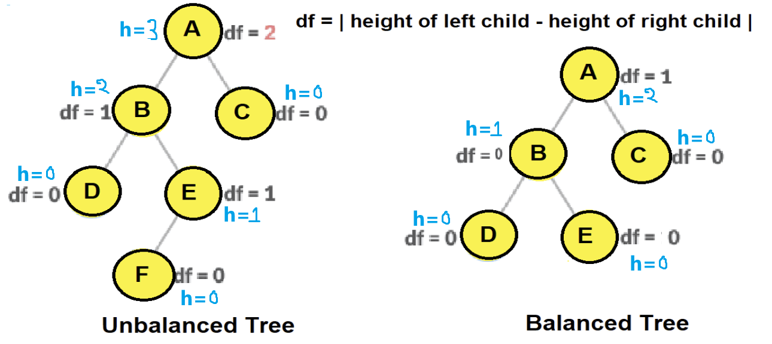
Types of Binary Tree
Balanced / Height-balanced Binary Tree:
The height of the left and right subtree of any node differ by not more than 1. (take absolute value).
Height: The length of the longest path from a node to one of its leaf nodes.
Always start checking from leaf nodes When df>1, say not balanced and STOP (df=0, 1 acceptable) If left or right subtree is missing, consider the height of that subtree to be -1
In the leftmost tree, the height of Node A’s left subtree is 2 and right subtree is 0. Therefore, the difference between these two is 2. | In the rightmost tree, no nodes have a height difference of more than 1 in between their left and right subtrees.
Trees Ch B.5, 10.4, 12.1

Slide 37
Types of Binary Tree
Full/Strict Binary Tree:
1) Every node has either 0 or 2 children.
2) No of leaf nodes = no of internal nodes + 1
Complete Binary Tree:
1) All internal nodes with two children.
2) If an internal node has one child, it must be on the left.
Perfect Binary Tree:
1) Every internal node has exactly two child nodes and
2) all the leaf nodes are at the same level.
Balanced/ Height-balanced Binary Tree:
The height of the left and right subtree of any node differ by not more than 1.
Trees Ch B.5, 10.4, 12.1

Slide 38
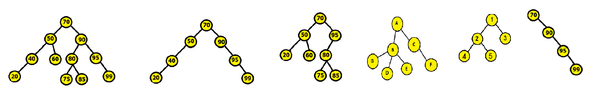
Types of Binary Tree
Full/Strict Binary Tree:
1) Every node has either 0 or 2 children.
2)No of leaf nodes = no of internal nodes + 1
Complete Binary Tree:
1) All internal nodes with two children.
2) If an internal node has one child, it must be on the left.
Perfect Binary Tree:
1) Every internal node has exactly two child nodes and
2) all the leaf nodes are at the same level.
Balanced/ Height-balanced Binary Tree:
The height of the left and right subtree of any node differ by not more than 1.
QUESTION: Identify which of the following trees are full, complete, perfect and balanced.
Trees Ch B.5, 10.4, 12.1

Slide 39
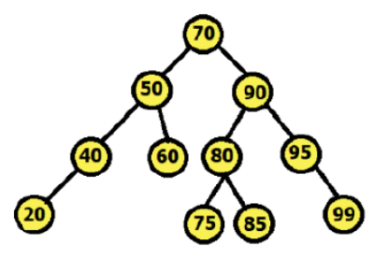
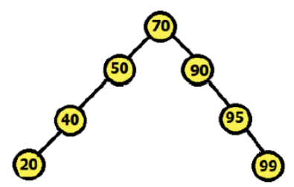
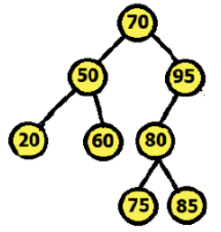
Identify Types of Binary Tree
Full | Internal nodes 40 and 95 have 1 children. So, not full | Except for 70, all nodes have 1 or 0 children. So, not full | Node 95 has 1 children. So, not full
Complete | 95 which is an internal node has 1 child which is on right. So, not complete | 95 which is an internal node has 1 child which is on right. So, not complete | A complete tree would not have missing nodes on the left before filling right; here there are gaps. So, not complete
Perfect | Internal nodes 40 and 95 have 1 children. So, not Perfect | Internal nodes (59, 40, 90, 95) have 1 children. So, not Perfect | Internal node 95 have 1 children. Not all leaves on same level. So, not Perfect
balanced | Yes | No | No
Trees Ch B.5, 10.4, 12.1

Slide 40
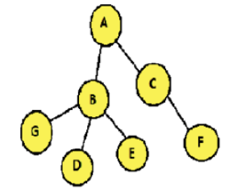
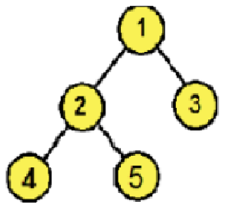
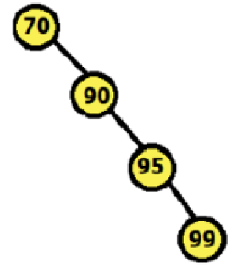
Identify Types of Binary Tree
Full | Not a binary tree. B has 3 children | all nodes have 2 or 0 children. So, full | all internal nodes have 1 children. So, not full
Complete | Not a binary tree. B has 3 children | internal nodes (1, 2) have 2 children. So, complete | 95 which is an internal node has 1 child which is on right. So, not complete
Perfect | Not a binary tree. B has 3 children | Internal nodes (1, 2) have 2 children. But leaf nodes (4, 5, 3) are not on same level. So, not Perfect | Internal nodes (70, 90, 95) have 1 children. So, not Perfect
balanced | Not a binary tree. B has 3 children | Yes | No
Trees Ch B.5, 10.4, 12.1

Slide 41
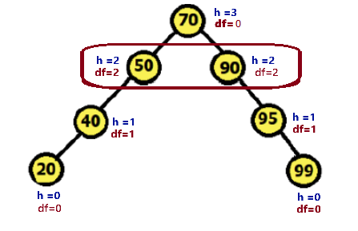
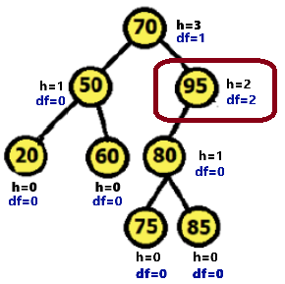
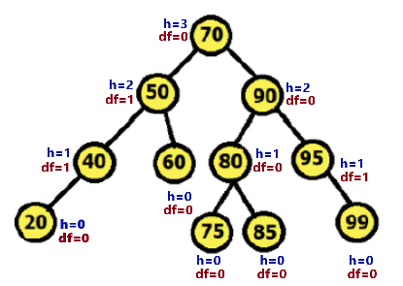
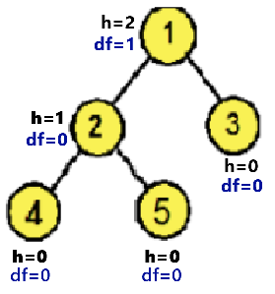
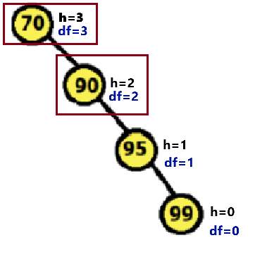
Check Balanced Binary tree
If left or right subtree is missing, consider the height of that subtree to be -1
Trees Ch B.5, 10.4, 12.1

Slide 42
Binary tree design
Each node has two child references: left and right.
If a node has fewer than two children, the unused child reference is set to NIL (Null/None).

Slide 43
Binary tree representation
There are two ways to represent binary trees:
Dynamic Representation (Using Linked List)
Sequential Representation (Using Array)
Representing rooted trees

Slide 44
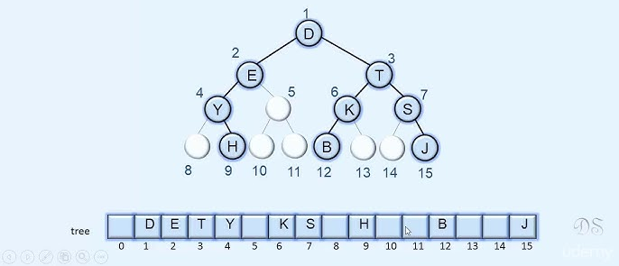
Sequential Representation (Using Array)
left=2*i
right= 2*i+1 i= parent_index parent = child_index//2
Image:⁸
⁸https://www.youtube.com/watch?v=0iHD18D072c

Slide 45
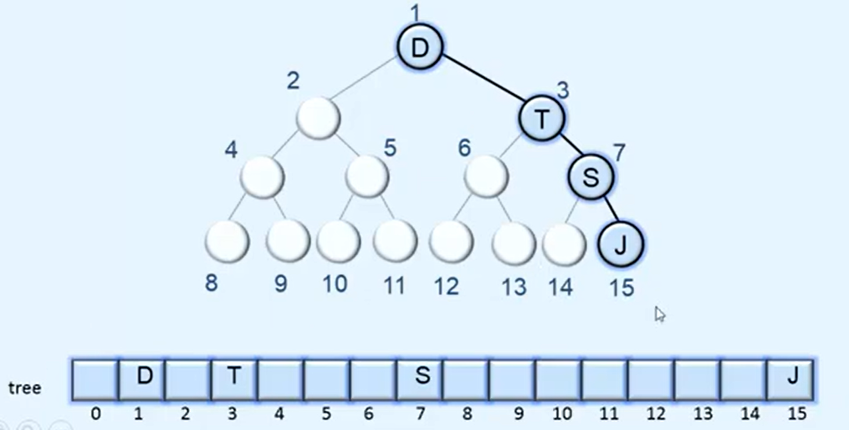
Sequential Representation (Using Array)
left=2*i
right= 2*i+1 i= parent_index parent = child_index//2
Problem: A left/right skewed binary tree has many empty array slots.
Image:⁸
⁸https://www.youtube.com/watch?v=0iHD18D072c

Slide 46
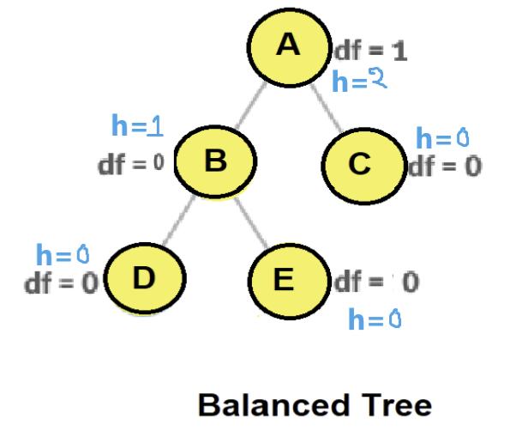
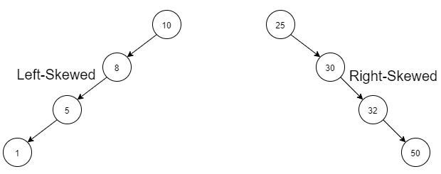
Sequential Representation (Using Array)
Balanced Binary Tree: Keeps left and right subtrees roughly equal in height, ensuring optimal performance.
Skewed Binary Tree: Almost all nodes have only one child, forming a linear structure (like a linked list)
Problem: A left/right skewed binary tree has many empty array slots.
Image:⁸
⁸https://www.youtube.com/watch?v=0iHD18D072c

Slide 47
Dynamic Representation (Using Linked List)
Binary tree Node class design
Style01 | Style02
a reference to its left child (may be NIL) a reference to its right child (may be NIL) a key/value | a reference to its parent (NIL for root) a reference to its left child (may be NIL) a reference to its right child (may be NIL) a key/value

Slide 48
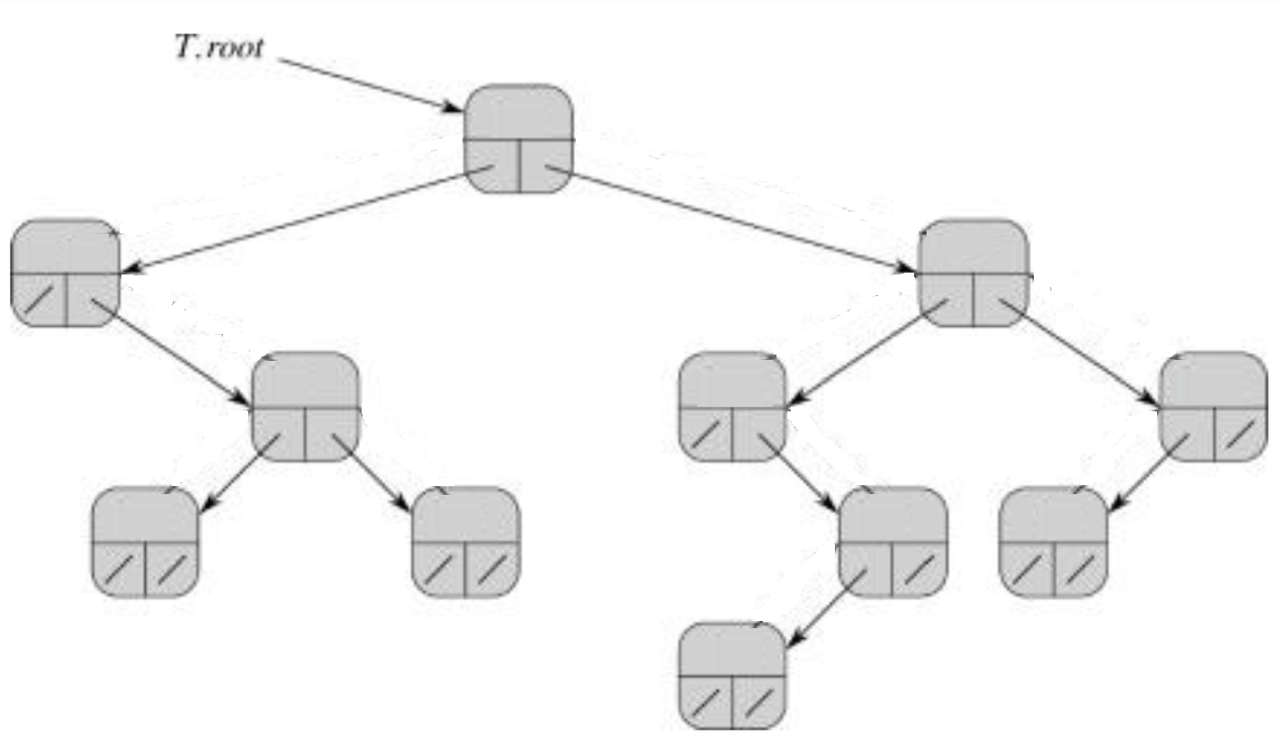
Dynamic Representation (Using Linked List) (style1)
Node class structure (style 1)
a reference to its left child a reference to its right child a key/value
Traversal: • Only downward (left/right) • No upward path to root
Image:⁸
⁸Cormen, Leiserson, Rivest, Stein. Introduction to Algorithms, 3rd edition, MIT Press, 2009

Slide 49
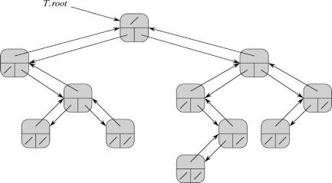
Dynamic Representation (Using Linked List) (style2)
Node class structure (style 2)
a reference to its parent a reference to its left child a reference to its right child a key/value
Traversal: Downward (left/right) Upward to root via parent
Image:⁸
⁸Cormen, Leiserson, Rivest, Stein. Introduction to Algorithms, 3rd edition, MIT Press, 2009

Slide 50
Navigating trees
Requirements
Each tree has exactly one root
Each node of the tree has exactly one parent (except root, which has no parent)
Starting from the root, there is (at least) one way to reach each node in a tree
The root of the tree can be reached from any node
Representing rooted trees

Slide 51
Tree Traversal
For Inorder, you traverse from the left subtree to the root then to the right subtree.
For Preorder, you traverse from the root to the left subtree then to the right subtree.
For Post order, you traverse from the left subtree to the right subtree then to the root.
Inorder => Left, Root, Right. Preorder => Root, Left,Right. Post order => Left, Right, Root.
Binary trees Ch 12.2–3

Slide 52
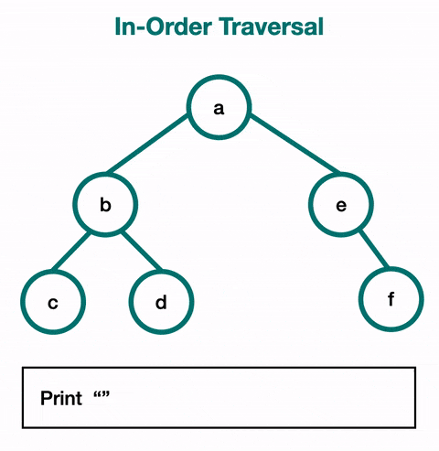
Tree Traversal (In order)
For Inorder, you traverse from the left subtree to the root then to the right subtree.
For Preorder, you traverse from the root to the left subtree then to the right subtree.
For Post order, you traverse from the left subtree to the right subtree then to the root.
Inorder => Left, Root, Right. Preorder => Root, Left,Right. Post order => Left, Right, Root.
Binary trees Ch 12.2–3

Slide 53

Tree Traversal (In order)
For Inorder, you traverse from the left subtree to the root then to the right subtree.
For Preorder, you traverse from the root to the left subtree then to the right subtree.
For Post order, you traverse from the left subtree to the right subtree then to the root.
Inorder => Left, Root, Right. Preorder => Root, Left,Right. Post order => Left, Right, Root. Inorder answer:Homework –solve it own your own
Binary trees Ch 12.2–3

Slide 54
Tree Traversal (In order)
For Inorder, you traverse from the left subtree to the root then to the right subtree.
For Preorder, you traverse from the root to the left subtree then to the right subtree.
For Post order, you traverse from the left subtree to the right subtree then to the root.
Inorder => Left, Root, Right. Preorder => Root, Left,Right. Post order => Left, Right, Root. Inorder answer:
Binary trees Ch 12.2–3

Slide 55

Tree Traversal (Pre-order)
For Inorder, you traverse from the left subtree to the root then to the right subtree.
For Preorder, you traverse from the root to the left subtree then to the right subtree.
For Post order, you traverse from the left subtree to the right subtree then to the root.
Inorder => Left, Root, Right. Preorder => Root, Left,Right. Post order => Left, Right, Root.
Binary trees Ch 12.2–3

Slide 56

Tree Traversal (Pre-order)
For Inorder, you traverse from the left subtree to the root then to the right subtree.
For Preorder, you traverse from the root to the left subtree then to the right subtree.
For Post order, you traverse from the left subtree to the right subtree then to the root.
Inorder => Left, Root, Right. Preorder => Root, Left,Right. Post order => Left, Right, Root. Preorder answer:Homework –solve it own your own
Binary trees Ch 12.2–3

Slide 57
Tree Traversal (Pre-order)
For Inorder, you traverse from the left subtree to the root then to the right subtree.
For Preorder, you traverse from the root to the left subtree then to the right subtree.
For Post order, you traverse from the left subtree to the right subtree then to the root.
Inorder => Left, Root, Right. Preorder => Root, Left,Right. Post order => Left, Right, Root. Preorder answer:
Binary trees Ch 12.2–3

Slide 58

Tree Traversal (post order)
For Inorder, you traverse from the left subtree to the root then to the right subtree.
For Preorder, you traverse from the root to the left subtree then to the right subtree.
For Post order, you traverse from the left subtree to the right subtree then to the root.
Inorder => Left, Root, Right. Preorder => Root, Left,Right. Post order => Left, Right, Root.
Binary trees Ch 12.2–3

Slide 59

Tree Traversal (post order)
For Inorder, you traverse from the left subtree to the root then to the right subtree.
For Preorder, you traverse from the root to the left subtree then to the right subtree.
For Post order, you traverse from the left subtree to the right subtree then to the root.
Inorder => Left, Root, Right. Preorder => Root, Left,Right. Post order => Left, Right, Root. Post order answer:Homework –solve it own your own
Binary trees Ch 12.2–3

Slide 60
Tree Traversal (post order)
For Inorder, you traverse from the left subtree to the root then to the right subtree.
For Preorder, you traverse from the root to the left subtree then to the right subtree.
For Post order, you traverse from the left subtree to the right subtree then to the root.
Inorder => Left, Root, Right. Preorder => Root, Left,Right. Post order => Left, Right, Root. Post order answer:
Binary trees Ch 12.2–3

Slide 61

Tree Traversal (post order)
–solve it own your own
Binary trees Ch 12.2–3

Slide 62
Tree Traversal (post order)
Binary trees Ch 12.2–3

Slide 63

Home work
Inorder => Left, Root, Right.
Preorder => Root, Left, Right.
Post order => Left, Right, Root.
Image:²
²https://www.geeksforgeeks.org
28/24

Slide 64
Home work
Inorder => Left, Root, Right. (4 10 12 | 15| 18 22 24| 25| 31 35 44| 50| 66 70 90)
Preorder => Root, Left, Right. (25 15 10| 4 12 | 22 18 24 | 50| 35| 31 44| 70 66 90)
Post order => Left, Right, Root. (4 12 10 | 18 24 22| 15 | 31 44| 35| 66 90 70| 50 25)
Image:²
²https://www.geeksforgeeks.org
28/24

Slide 65

Home work
Inorder => Left, Root, Right.
Preorder => Root, Left, Right.
Post order => Left, Right, Root.
28/24

Slide 66

Home work
28/24

Slide 67
The End

